Slide 1

Intro to Java Day 4- Loops!
By: Nishant Malpani

Slide 2
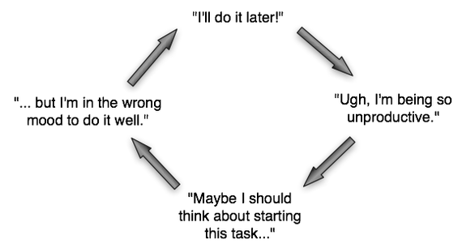
What is a loop?
A loop is exactly what it sounds like- it is something that allows you to loop over elements!
Loops are extremely useful and powerful as they allow you to do much more with code, so congratulations for hitting this milestone!
Before I jump into showing you what a loop, let’s understand why we need them in the first place.

Slide 3
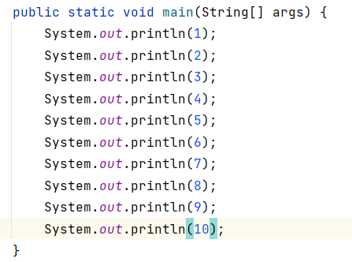
Why do we need loops?
Let’s say we want to print out the first ten numbers as a list.
To do this, we would write System.out.println(number) 10 times.
This in itself is already very tedious. Imagine if we had to do this 50 times, 100 times, or even 1000 times?
Clearly, writing it out this way is unscalable for anything with larger numbers.

Slide 4
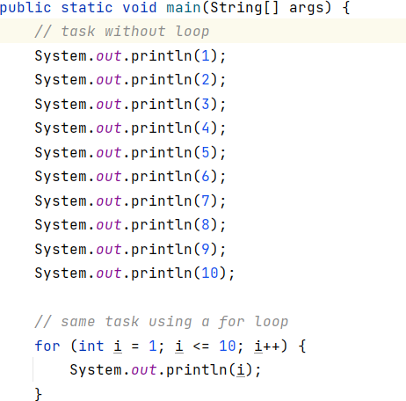
Why do we need loops?
Repeating tasks over and over are what loops shine in doing.
I’m going to show you the code for doing the same task we just did (printing the first ten numbers) but using a loop. Notice the difference!
While right now the loop probably looks very confusing, I’m going to break it down to you to show you really how simple and efficient it is!

Slide 5
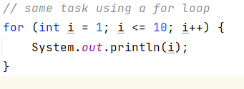
For Loops
The loop I used for this problem is called a for loop. It is one of the most common loops used in any programming language.
The first thing we notice is the keyword for at the start of the loop. This indicates that it is a for loop.

Slide 6
For Loops
The next thing we notice is in the parentheses after the word for, there are three things:
Declaration: Declaring an int i and setting it to one
Condition: Setting i to be less than or equal to 10
Iteration: Incrementing i by one
These three things, namely Declaration, Condition, and Iteration are the three main parts of a for loop. Let’s discuss them more.

Slide 7
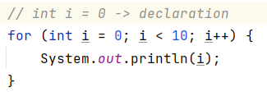
Declaration
The first part of the for loop inside the parentheses is the declaration. In the declaration, we tell the console the number we want to start looping at. For example, if we want to loop from 1 to 10, we would set (declare) i to 1.
Note: i and j are two very common variable names for loops. Don’t get scared by them- they are just like any other variable!
What should we set i to if we want to count down the first 100 numbers?

Slide 8
Condition
The second part of the for loop inside the parentheses is the condition. In the condition, we tell the console how long we want to loop until, and when we want to stop looping. For example, if we want to loop from 1 to 10, we would write i <= 10. This tells the console to keep looping while i is less than or equal to 10. Once i becomes greater than 10, the loop will stop running.
Note: It is crucial to set this part of the loop! If there is no condition in a for loop, it will never stop running!
What should the condition of our loop be assuming we have an int i = 0 and want to print out the first 24 numbers? Can anyone think of two possible conditions?

Slide 9
Iteration
The third part of the for loop inside the parentheses is the iteration. In the iteration, we tell the console how much we want to increase i by each time the loop runs. For example, if we want to loop from 1 to 10, we would write i++ for our iteration. This tells the console that each time the loop runs, to increase the value of i by one. Once i exceeds the value of the condition, the loop will break and stop running.
Note: It is crucial to set this part of the loop! If there is no iteration, then i will stay the same value and never increase!
What should the condition of our loop be assuming we have declared int i = 10 and set the condition to be i >= 1 and want to count down the first 10 numbers?

Slide 10
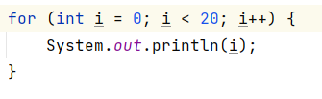
Putting it all Together!
The body of the for loop is where all the code you want to execute each time you run goes.
Can someone tell me what happens in this for loop? What is the declaration, condition, and interaction?

Slide 11

Practice with For Loops
Let’s get some practice with for loops! Everyone take a minute and make a for loop that prints out the first 5 numbers!
Feel free to ask any questions!
Notes:
Possibly add animation

Slide 12
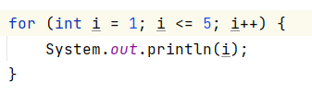
Practice with For Loops
Good job everyone! Now try solving the next two problems using for loops:
Countdown the first 12 numbers and print them out.
Print out the first 10 positive even numbers.
Notes:
Possibly add animation

Slide 13
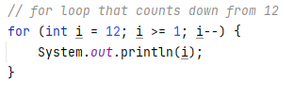
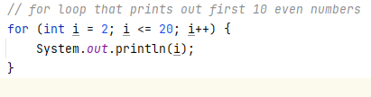
Practice with For Loops
Does anyone have any questions? These problems are tricky!
Notes:
Possibly add animation

Slide 14
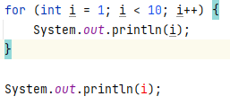
Scope of For Loops
One thing I want to mention is the scope of a for loop.
Why is an error showing up when I try to print i outside of the for loop?
The reason is because i is out of the scope of the loop. The variable i was defined in the for loop, and is only known in the for loop. Outside of the loop, the console doesn’t recognize it.
We will definitely talk about scope more in future lessons. For now, it’s just good to know what will happen in scenarios like this.
Notes:
Possibly add animation

Slide 15
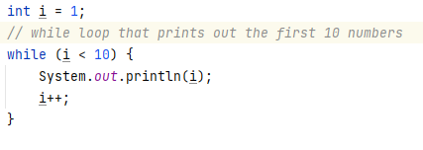
While Loops
While loops are another very common type of loop in all programming languages. Conceptually, they are a lot like for loops- they will run until the condition is false. However, the main difference between the two types of loops is the declaration.
Share out some differences you see between for and while loops!
Notes:
Possibly add animation

Slide 16
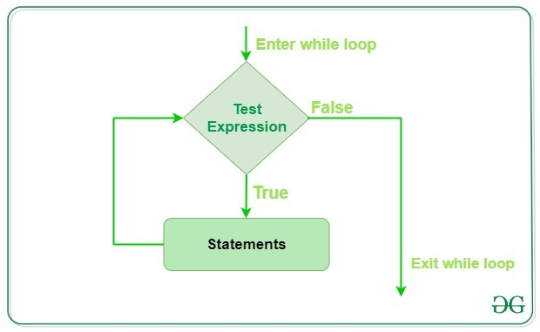
While Loops
A while loop only accepts a condition, and will keep running until the condition is false. It is important that inside the while loop, you iterate the variable in the condition- otherwise the loop will run forever! Also, you must define the variable in the condition before the loop.
Notes:
Possibly add animation

Slide 17
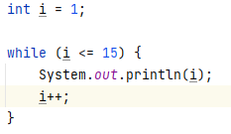
Practice with While Loops
Let’s get some practice with while loops! Make a while loop that prints out the first 15 numbers!
Notes:
Do an animation between the question and answer

Slide 18
For Loops vs While Loops
How do you decide whether to use a for loop or a while loop?
While you can use both in pretty much all scenarios, based on the scenario one is generally easier to use than the other.
For example, if you know the amount of times you want to iterate (like printing the first 10 numbers), then a for loop is a better choice.
On the other hand, if you don’t know the number of times you want to iterate (an example being when you are checking for something in a list), a while loop might be more convenient.
Notes:
Do an animation between the question and answer

Slide 19
That’s it for today!
Any questions? Loops are fun and a very powerful tool that you will use frequently in your programming future! It’s important to fully understand them.
What we learned:
- For loops
- While loops
- Practiced using the loops
Notes:
Do an animation between question and visual

Slide 20
Thank You For Coming!
Please check out the Redmond Code Association website for more events and resources!

